Slide 1
“Ez2BUY” E-commerce Web aPP
Ali SAYED
Andrew Yasser
Bassel Hatem
Farah Sherif
Maha Mohamed

Slide 2
Agenda
Introduction
Requirements analysis, HLD & technologies
Live Demo
LLD: Code implementation
Testing and Deployment

Slide 3
High-level Design (HLD)
Requirements Gathering & Analysis
ERD and DB Schema
UML diagrams
Architectural Decisions
Technology Stack Selection

Slide 4
Functional Requirements
User Management
Product Catalog search and filter
Order Placement & Shopping Cart
Payment gateway integration
Email notification for confirmation
Administration features for user, products, and orders

Slide 5
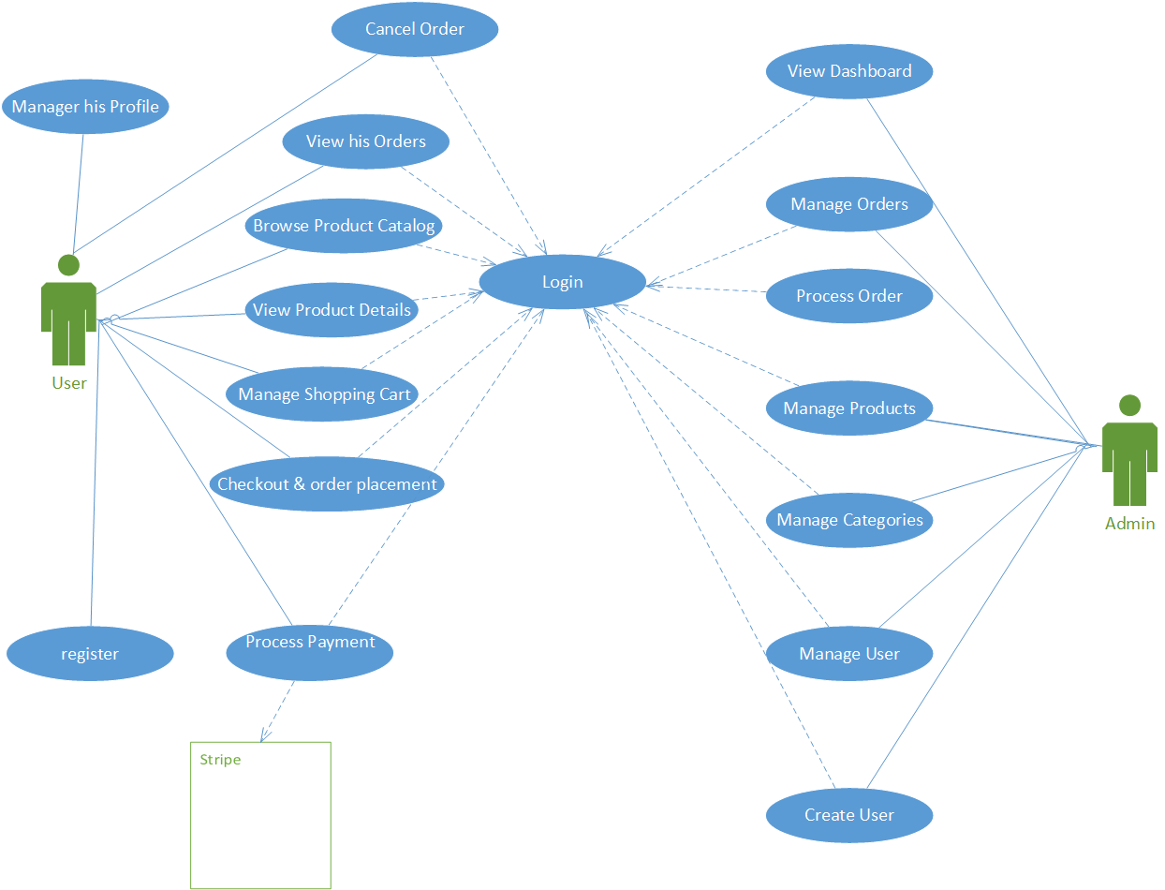
Use Case Diagram: personas & Actions

Slide 6
Non-Functional Requirements
Usability: Responsive design for device types
Security: role-based Access
Reliability & Availability: Comprehensive error handling
Maintainability: Clean code with Comprehensive documentation and Unit tests coverage

Slide 7
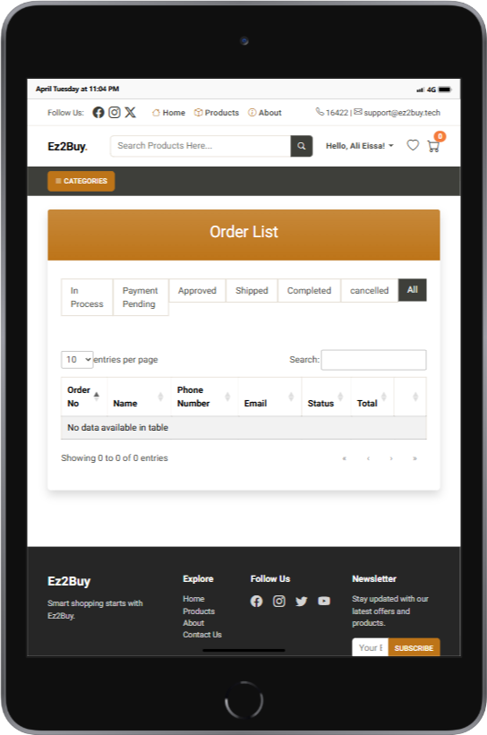
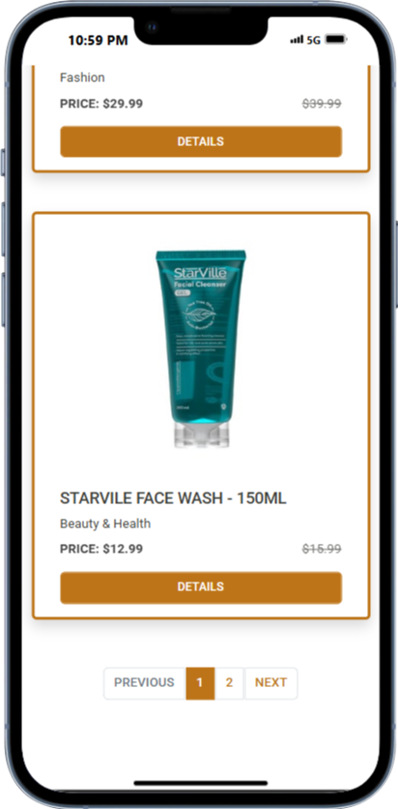
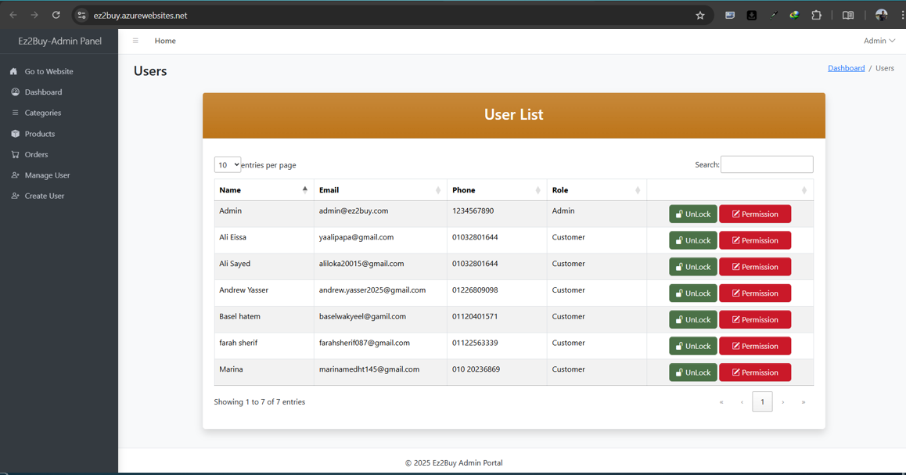
Fully-Responsive Design

Slide 8
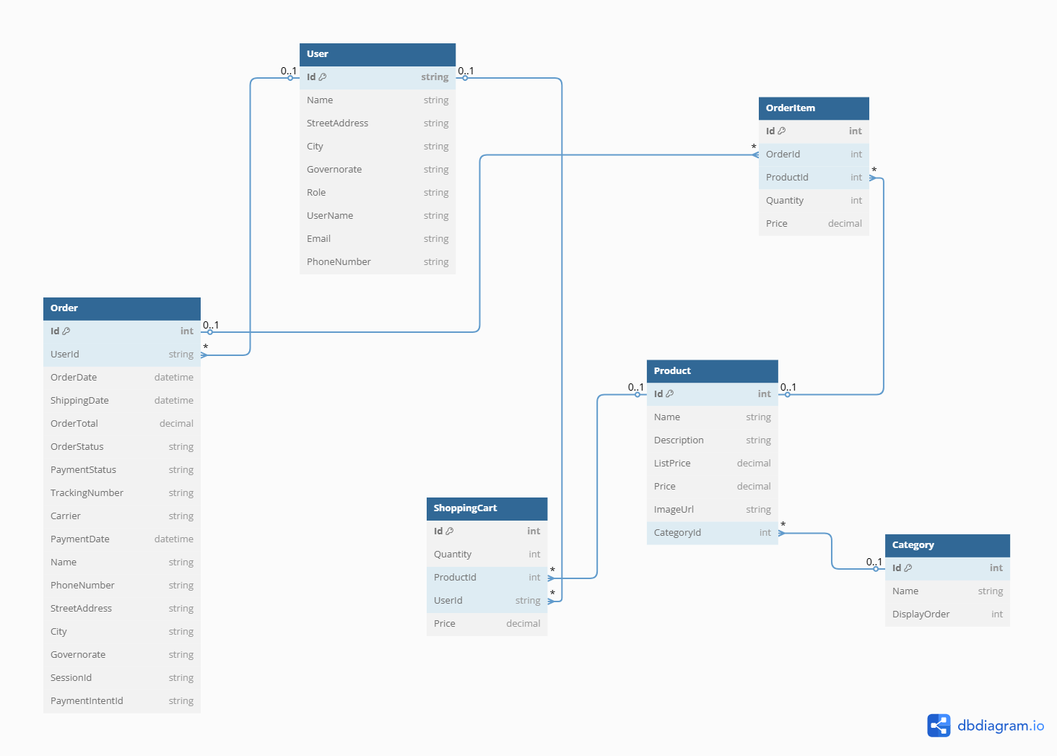
ERD

Slide 9
Architectural Decisions
layered architecture:
Presentation Layer: MVC Controllers and Views
Data Access Layer: UnitOfWork and Repository implementations
Data Layer: Entity Framework Core with SQL Server
Repository Pattern for data access abstraction
Unit of Work Pattern for transaction management
MVC Pattern for separation of concerns
ViewModel Pattern for UI data shaping
Using Session data to save data for shopping cart

Slide 10
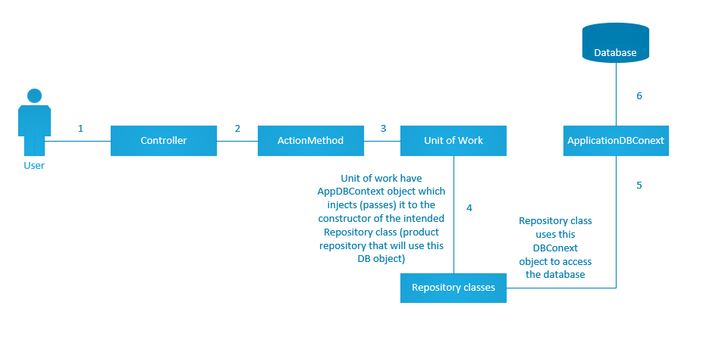
Architecture OverView

Slide 11
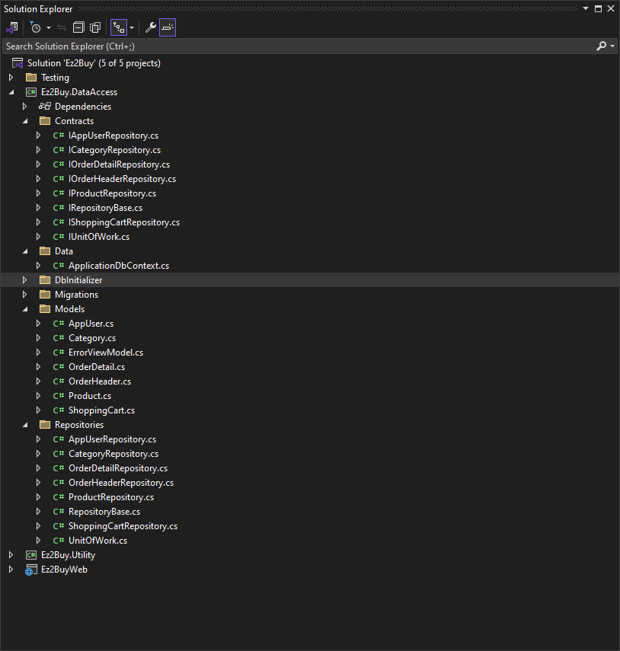
Project structure

Slide 12
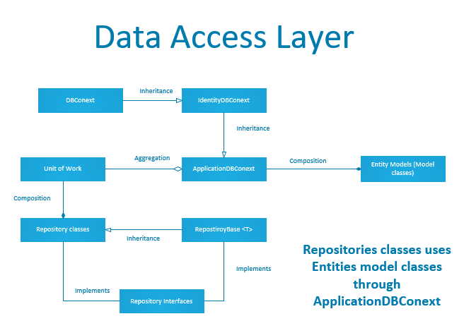
Class Diagram for Data Access Layer

Slide 13
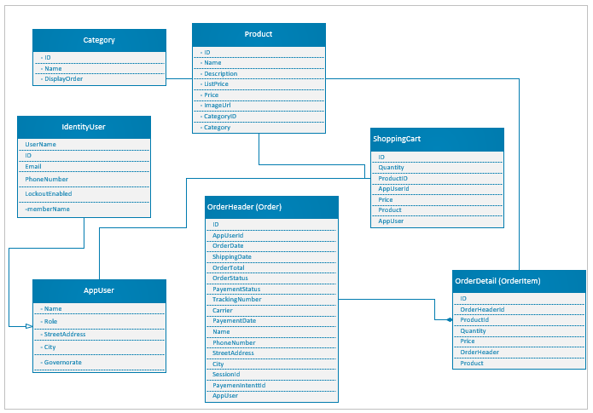
Model Classes

Slide 14
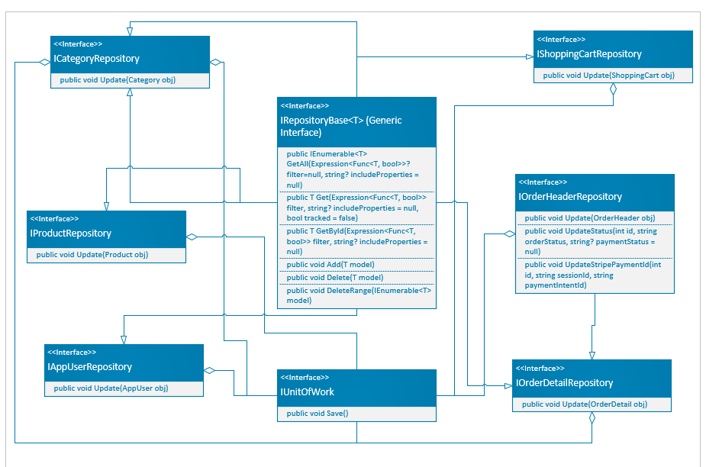
Repository Interfaces

Slide 15
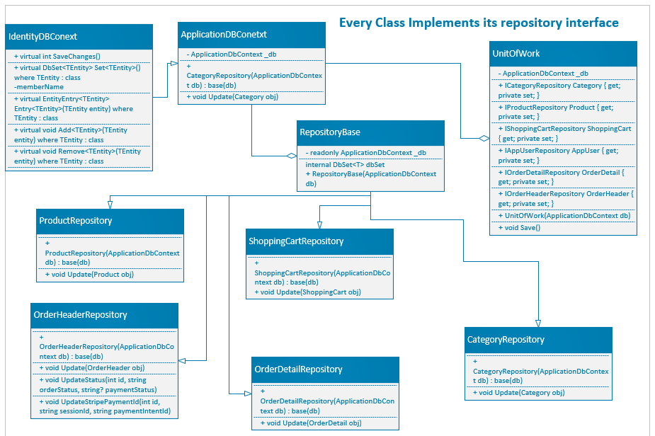
Repository classes Diagrams

Slide 16
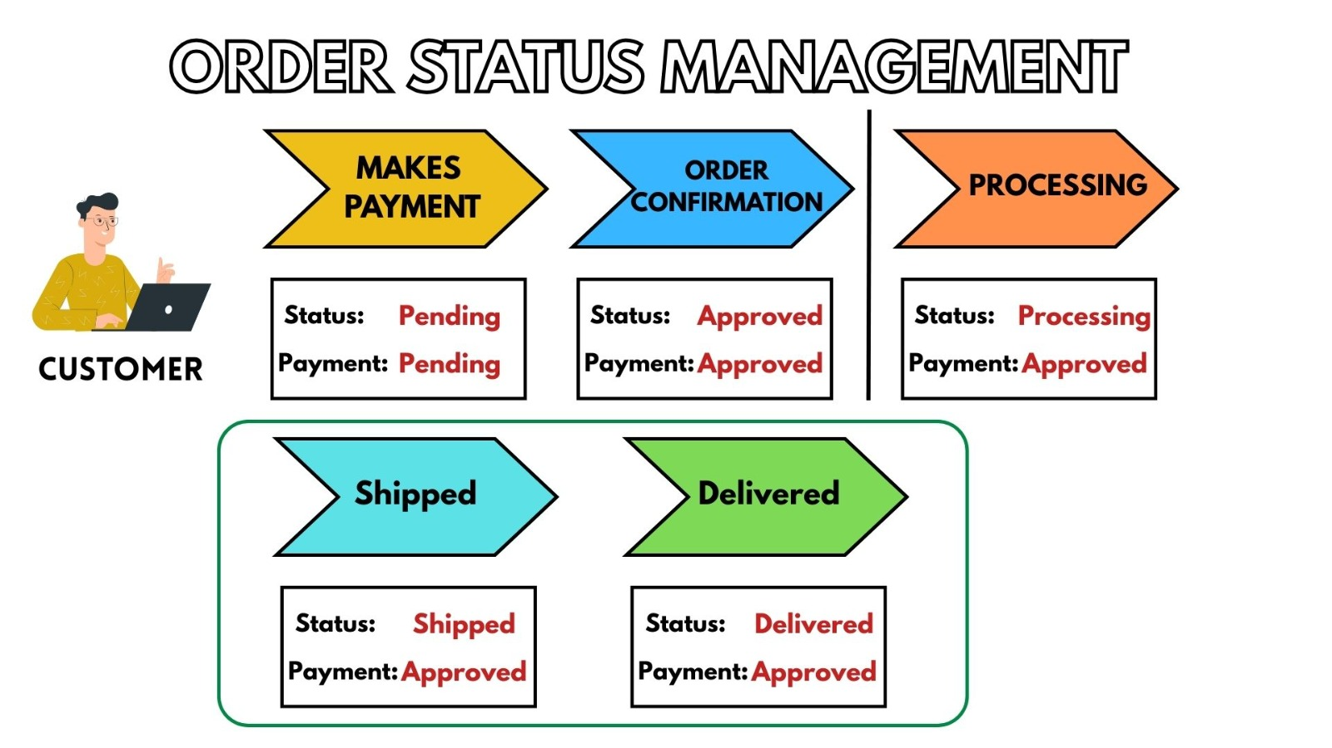
Sequence Diagram – order placement
Order cannot
be cancelled
from here

Slide 17
Technology Stack Selection
ASP.NET 8.0 Core MVC web framework
Entity Framework Core
ASP.NET Core Identity

Slide 18
jQuery
JavaScript library for DOM manipulation, AJAX, and event handling
Bootstrap
Frontend framework for responsive design and UI components
Toastr.js
Notification library for elegant toast messages.
DataTables
plugin for advanced HTML table interactions.
SweetAlert
Stylish alert dialog replacement (popup).
TinyMCE
rich text editor for user content input.
Stripe
Secure online payment gateway for handling transactions and subscriptions.
SendGrid
Email API for sending transactional and marketing emails.

Slide 19
Middle Wares
1. app.UseHttpsRedirection()
2. app.UseRouting()
3. app.UseAuthentication()
4. app.UseAuthorization()
5. app.UseSession()

Slide 20
Live Demo
Click here: Link to the Web APP

Slide 21
Code Implementations

Slide 22
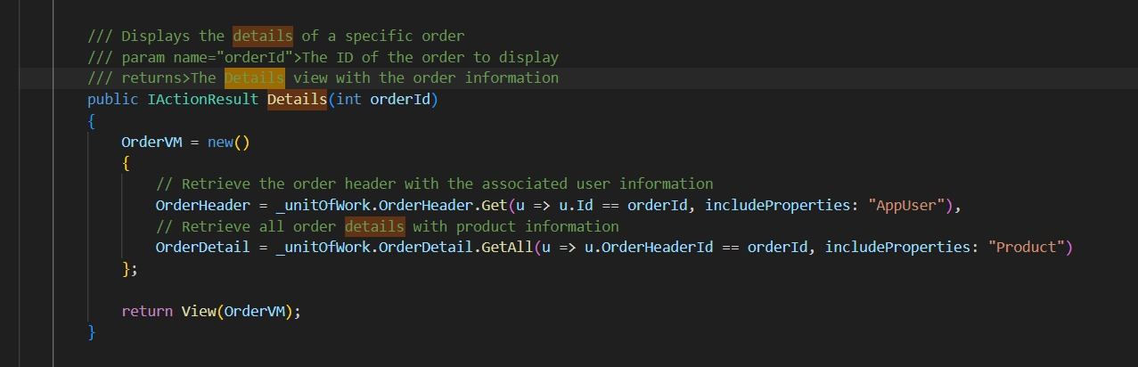
Order Controller

Slide 23
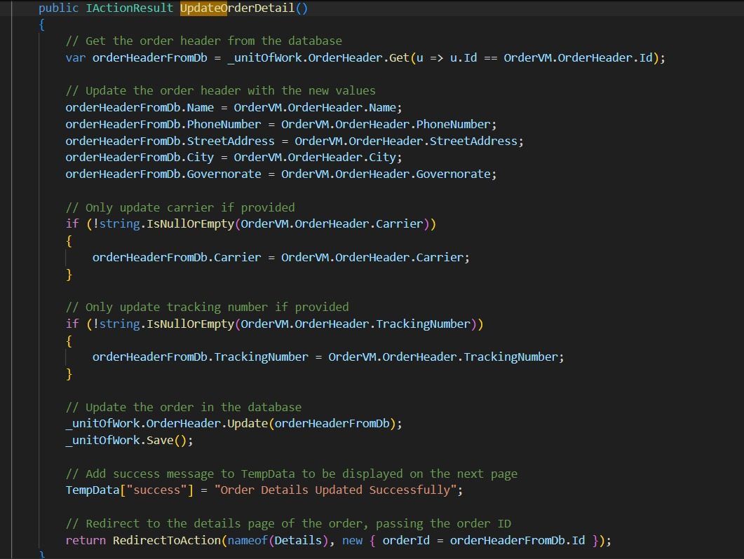

Slide 24
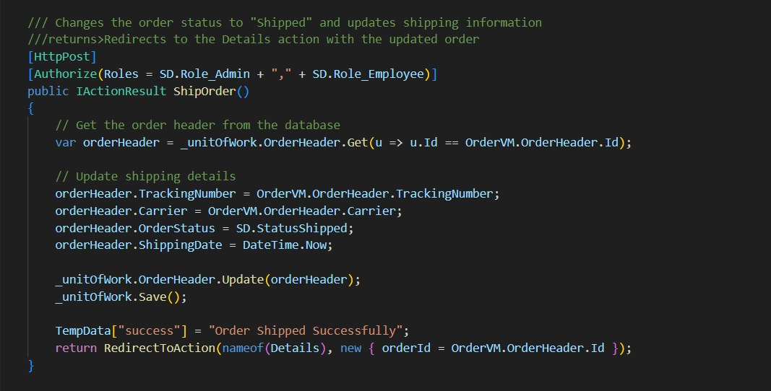

Slide 25
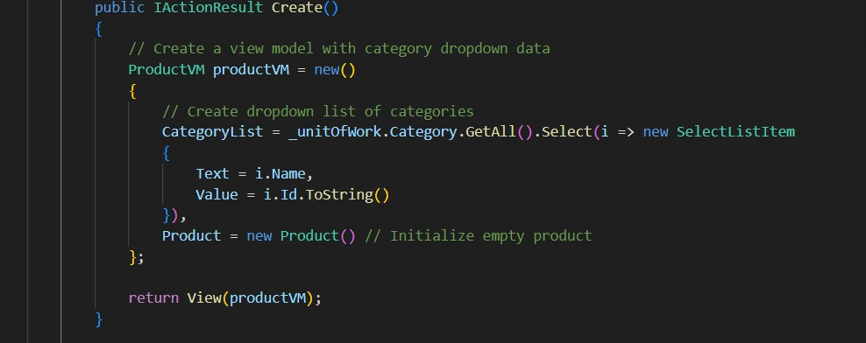
Product Controller

Slide 26
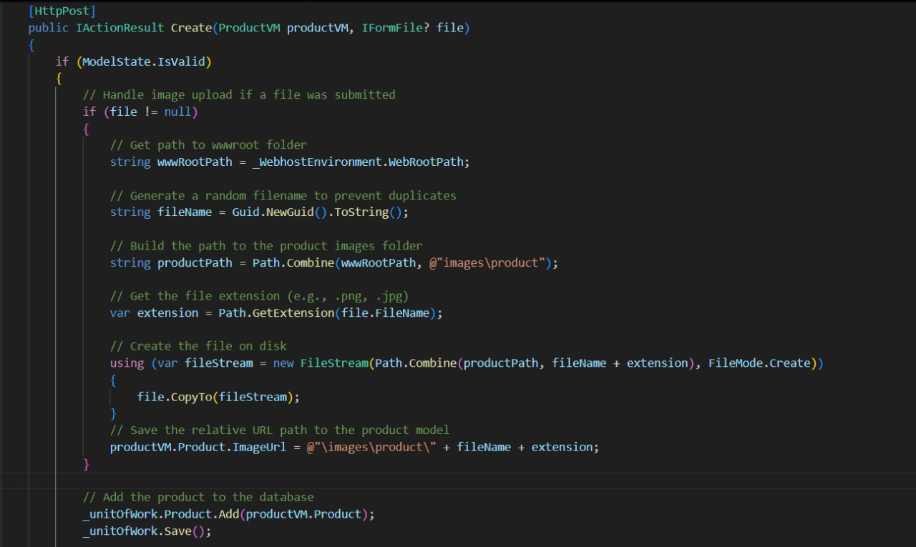

Slide 27
Testing & code Coverage

Slide 28
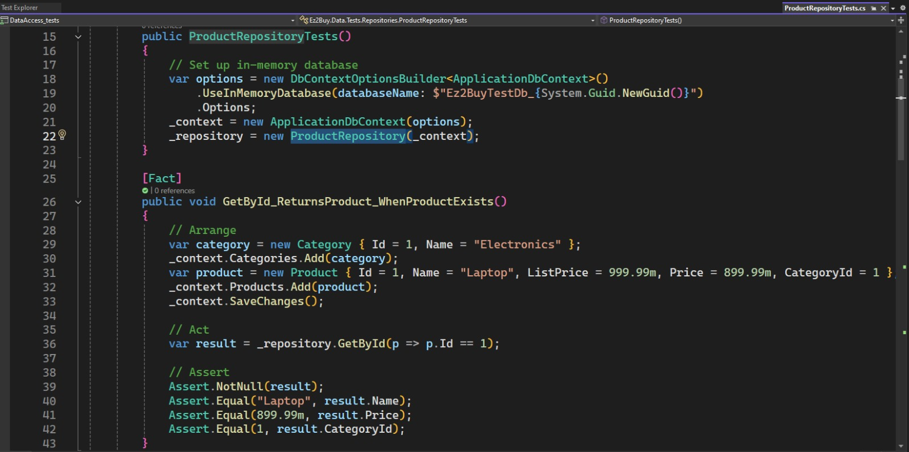
Unit testing using XUNIT

Slide 29
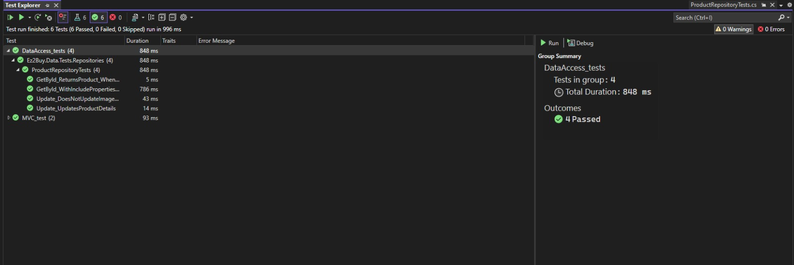
Unit testing using XUNIT

Slide 30
Deployment

Slide 31

Microsoft Azure
ez2buy (App Service)
Ez2BuyWebFreePlan (App Service Plan)
ez2buywebdbserver (SQL Server)
Ez2BuyWeb_db (SQL Database)

Slide 32
Advanced User Experience
completing API versions
AI-powered product recommendations based on browsing and purchase history
Live chat support or chatbot for instant customer help
Voice search integration for accessibility and convenience
adding Wishlist's and Products Reviews
Enhanced Security & Trust: Fraud detection mechanisms
Supplier/vendor registration and approval workflow
Supplier dashboard with analytics, product status, and earnings

